Slide 1
Hashing (Chapter 21 & 22)
Manar Mohamed
mohamem@miamioh.edu

Slide 2
Big Picture Questions:
What is hashing?
What problem does it solve for us?
What are the implementation details?

Slide 3
Dictionaries:
Important because they help us look up information
Look up a phone number for a person
Look up a definition for a word
Look up the next move in tic tac toe
Look up the location of a restaurant
Dictionaries require looking up information
When we add, we need to look up the key to see if it already exists
When we get, we need to look up the key to get its value
When we remove, we need to look up the key to find the object to remove
Therefore…We want "lookup" to be fast

Slide 4
Unsorted-array implementation:
As you read, ask yourself "what is the time complexity?"
When adding, search for the key.
If found, update the value
If not found, add the key-value pair to the end of the array
When getting, search for the key.
If found, return the value
If not found, return null
When removing, search for the key.
If found, replace that entry with the last entry in the array, remove the last entry, return the key's value
If not found, return null

Slide 5
What is the efficiency of add()?
O(1)
O(log n)
O(n)
O(log n)
O(n log n)

Slide 6
What is the efficiency of getValue()?
O(1)
O(log n)
O(n)
O(log n)
O(n log n)

Slide 7
What is the efficiency of remove()?
O(1)
O(log n)
O(n)
O(log n)
O(n log n)

Slide 8
Sorted-array implementation:
As you read, ask yourself "what is the time complexity?"
When adding, search for the key.
If found, update the value
If not found, insert the key-value pair, shifting elements to make room
When getting, search for the key.
If found, return the value
If not found, return null
When removing, search for the key.
If found, shift elements to remove the entry, return the key's value
If not found, return null

Slide 9
What is the efficiency of add()?
O(1)
O(log n)
O(n)
O(log n)
O(n log n)

Slide 10
What is the efficiency of getValue()?
O(1)
O(log n)
O(n)
O(log n)
O(n log n)

Slide 11
What is the efficiency of remove()?
O(1)
O(log n)
O(n)
O(log n)
O(n log n)

Slide 12
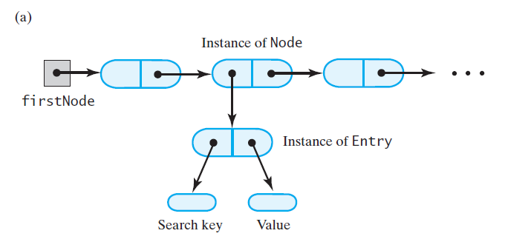
Linked-node dictionaries:
Could implement an unsorted or a sorted
All operations are O(n)
Because all require a linear search

Slide 13
Can we do better than O(n) for dictionaries?
Hashing:
Ideally can get us O(1) for add, getValue, remove
Uses an array
Hashing is designed to help us quickly determine where in the array to place the key-value pair
Doesn't depend on the size of the dictionary

Slide 14
Hashing:
Big idea:
What if we could quickly calculate an integer for any object
We could use that integer to tell us where to put the object in the array
That integer is called the object's "hash code"

Slide 15
Hashing
A technique that determines an index into a table using only an entry’s search key
Hash function
Takes a search key and produces the integer index of an element in the hash table
Search key is mapped, or hashed, to the index

Slide 16
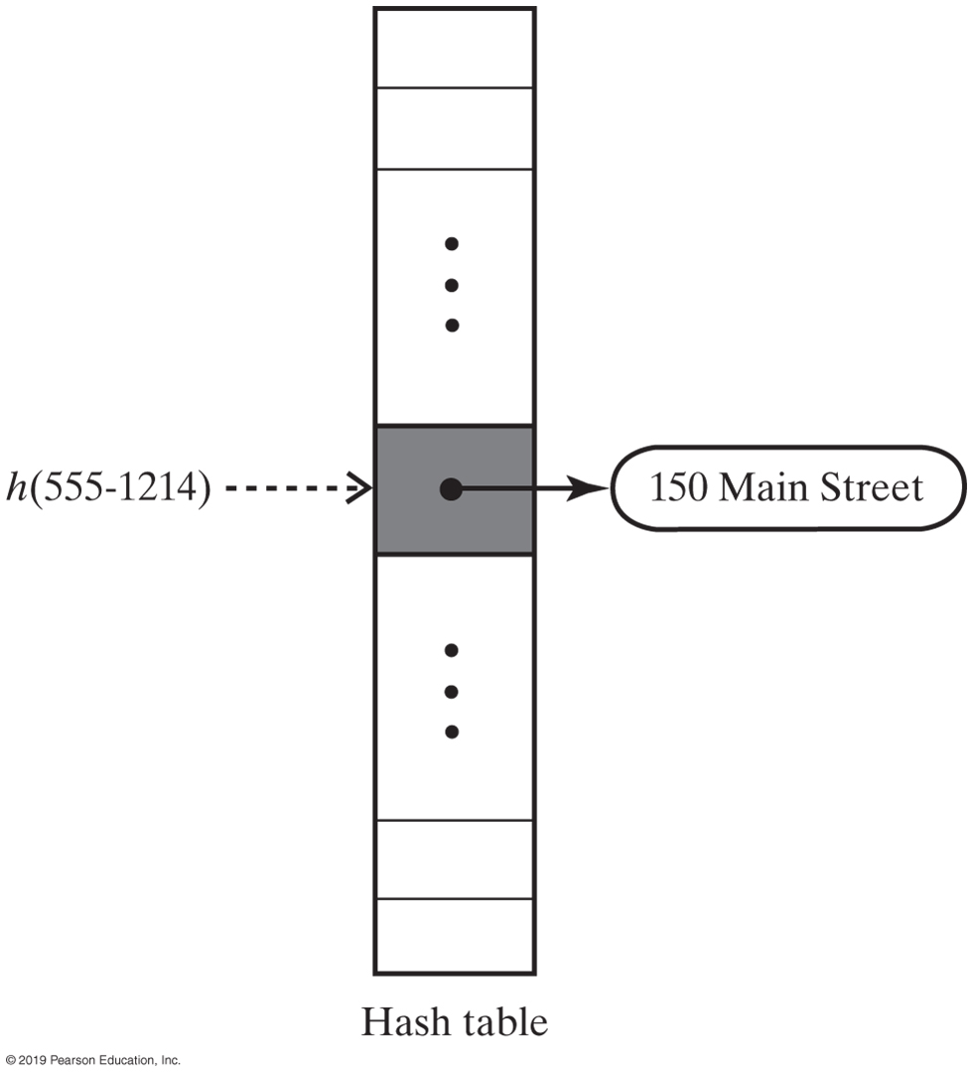
Hash Table
FIGURE 21-1 A hash function indexes its hash table

Slide 17
Ideal Hashing
Algorithm add(key, value)
index = h(key)
hashTable[index] = value
Algorithm getValue(key)
index = h(key)
return hashTable[index]
Simple algorithms for the dictionary operations that add and retrieve

Slide 18
Typical Hashing
Typical hash functions perform two steps:
Convert search key to an integer
Called the hash code.
Compress hash code into the range of indices for hash table.
Algorithm getHashIndex(phoneNumber)
// Returns an index to an array of tableSize elements.
i = last four digits of phoneNumber
return i % tableSize

Slide 19
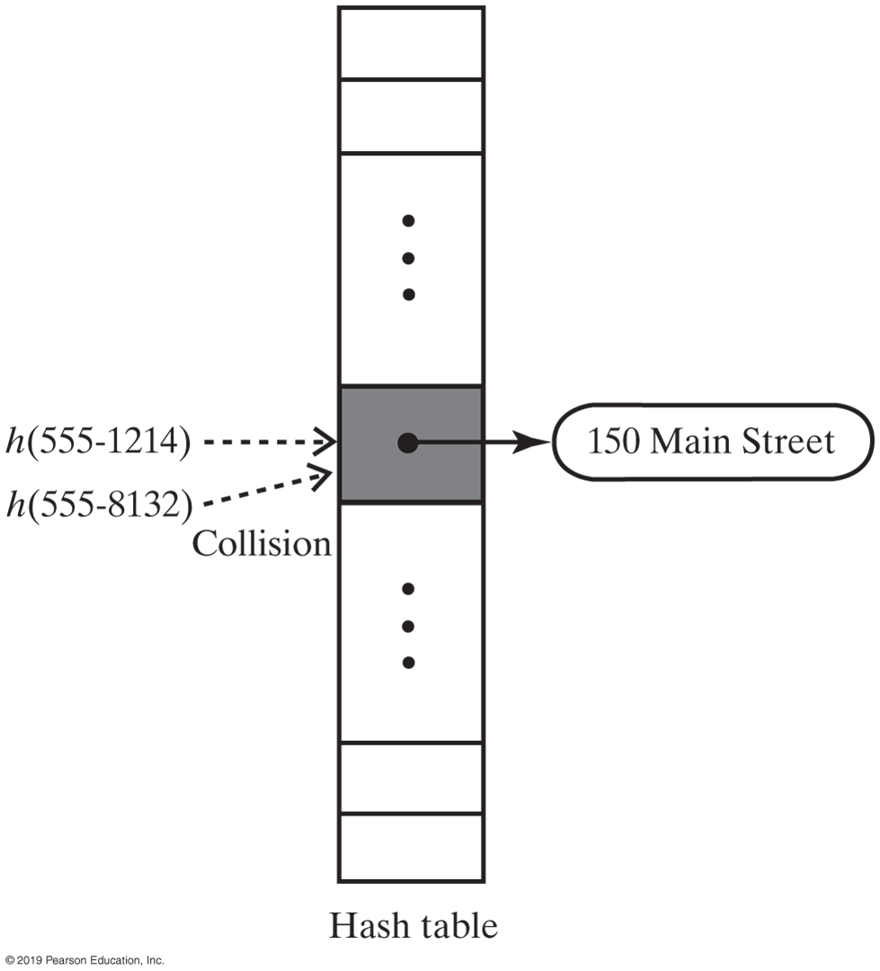
Typical Hashing
Most hash functions are not perfect,
Can allow more than one search key to map into a single index
Causes a collision in the hash table
Consider tableSize = 101
getHashIndex(555-1214) = 52
getHashIndex(555-8132) = 52 also!!!
FIGURE 22-2 A collision caused by the hash function h

Slide 20
Hash Functions
A good hash function should
Minimize collisions
Be fast to compute
To reduce the chance of a collision
Choose a hash function that distributes entries uniformly throughout hash table.

Slide 21
Computing Hash Codes
Java’s base class Object has a method hashCode that returns an integer hash code
A class should define its own version of hashCode

Slide 22
equals() and hashCode()
If two objects are the same using equals(), then they should have the same hashCode().
The reverse is not necessarily true (and is sometimes impossible).
The Object class has its own equals() and hashCode() methods.
equals() just compares memory addresses
hashCode() just uses memory addresses
When you design your own classes:
If you write an equals() method, you should also be writing a corresponding hashCode() method.
Make sure that two "equal" objects will return the same hashCode

Slide 23
Example:
What if you wanted to store your data using a phone number as the key?
Examples:
529-3036
523-1234
523-9036
Option 1: Hash function that uses all 7 digits as the int.

Slide 24
Example:
What if you wanted to store your data using a phone number as the key?
Examples:
529-3036
523-1234
523-9036
Option 2: Hash function that uses only the last 4 digits as the int
This is generally considered bad. Hash functions should make use of ALL of the data

Slide 25
Example:
What if you wanted to store your data using String as the key?
Examples:
"CAT"
"DOG"
"SPOT"
Option 1: Add the ASCII (or Unicode) values together.
The problem is that there could be many "collisions"...lots of strings with the same hash code.
Collisions are often inevitable, but we try to avoid them.

Slide 26
Example:
What if you wanted to store your data using String as the key?
Examples:
"CAT"
"DOG"
"SPOT"
Option 2: A position-based system. (This technique is known as Horner's method.)
'S' * 31³ + 'P' * 31² + 'O' * 31¹ + 'T'

Slide 27
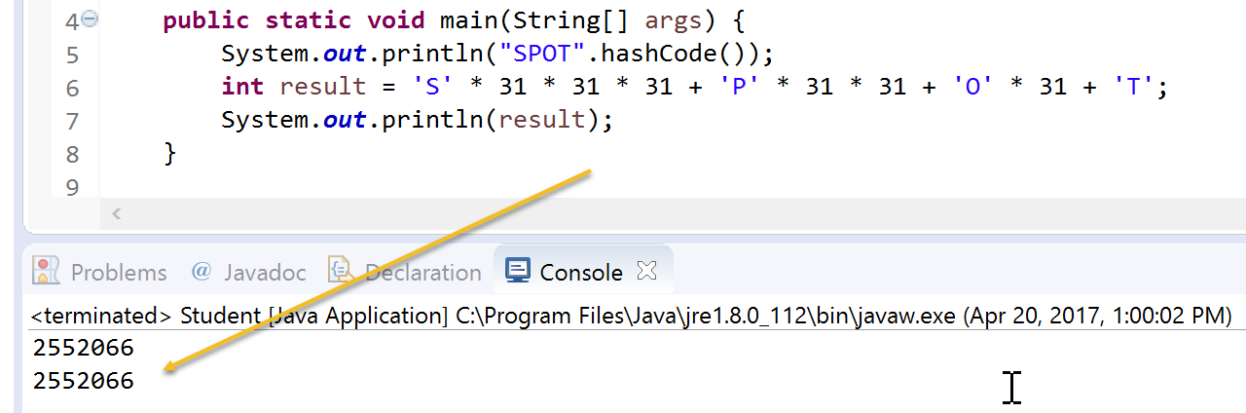
Horner's method == hashCode() for String

Slide 28
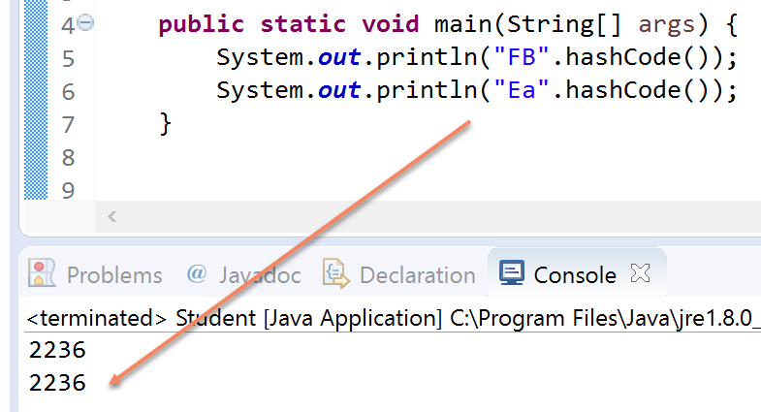
Is the String hashCode() perfect?

Slide 29
Hash Code for a Primitive type
If data type is int,
Use the key itself
For byte, short, char:
Cast as int
Other primitive types
Manipulate internal binary representations

Slide 30
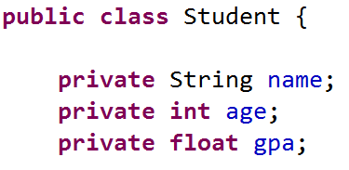

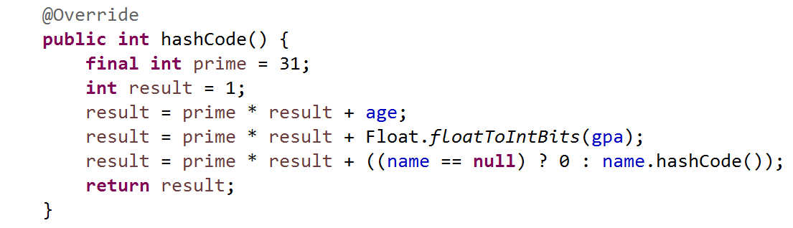
Eclipse will help you generate a hashCode function:

Slide 31
Compressing a Hash Code
Common way to scale an integer
Use Java mod operator %: code % n
Best to use an odd number for n
Prime numbers often give good distribution of hash values

Slide 32
Compressing a Hash Code
Hash function for the ADT dictionary
private int getHashIndex(K key)
{
int hashIndex = key.hashCode() % hashTable.length;
if (hashIndex < 0)
hashIndex = hashIndex + hashTable.length;
return hashIndex;
} // end getHashIndex

Slide 33
Resolving Collisions
Collision:
Hash function maps search key into a location in hash table already in use
Two choices:
Use another location in the hash table
Change the structure of the hash table so that each array location can represent more than one value

Slide 34
Resolving Collisions
Linear probing
Resolves a collision during hashing by examining consecutive locations in hash table
Beginning at original hash index
Find the next available one
Table locations checked make up probe sequence
If probe sequence reaches end of table, go to beginning of table (circular hash table)

Slide 35
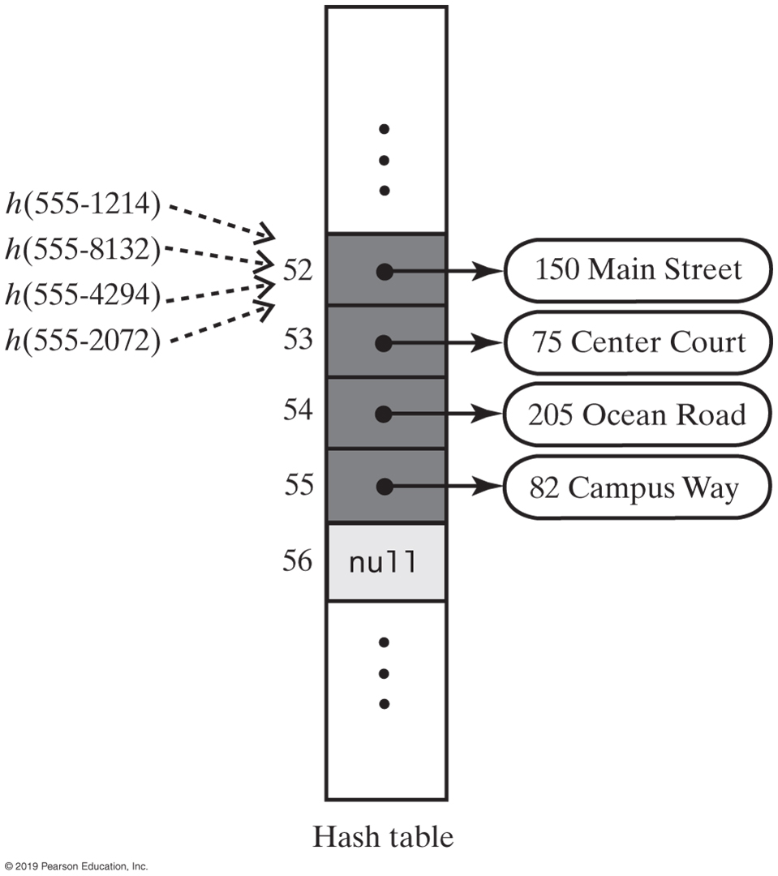
Linear Probing
adreessBook.add(“555-1264”, “150 Main Street”);
adreessBook.add(“555-8132”, “75 Center Court”);
adreessBook.add(“555-4294”, “205 Ocean Road”);
adreessBook.add(“555-2072”, “82 Campus Way”);

Slide 36
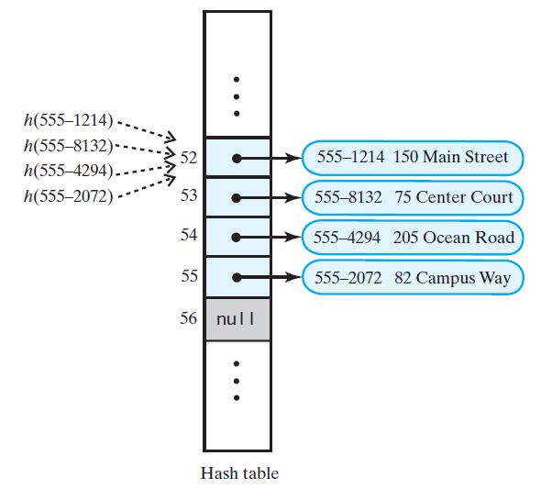
Linear Probing
adreessBook.add(“555-1264”, “150 Main Street”);
adreessBook.add(“555-8132”, “75 Center Court”);
adreessBook.add(“555-4294”, “205 Ocean Road”);
adreessBook.add(“555-2072”, “82 Campus Way”);

Slide 37
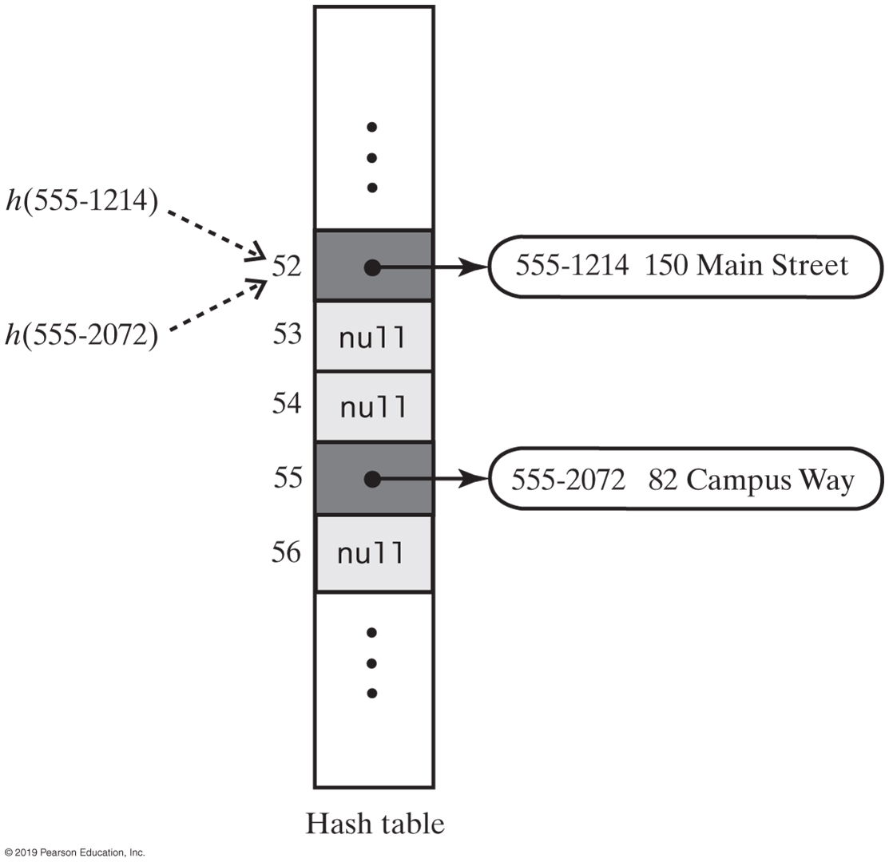
Linear Probing
FIGURE 22-5 A hash table if remove used null to remove entries

Slide 38
Example of linear probing:
Using a hash function of k % 7, add the following values to a hash table of size 7, using linear probing to resolve collisions:
5, 24, 14, 12, 20

Slide 39
Resolving Collisions
Need to distinguish among three kinds of locations in the hash table
Occupied
location references an entry in the dictionary
Empty
location contains null and always has
Available
location’s entry was removed from the dictionary

Slide 40
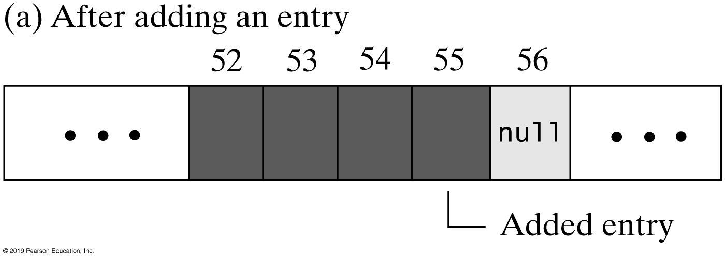
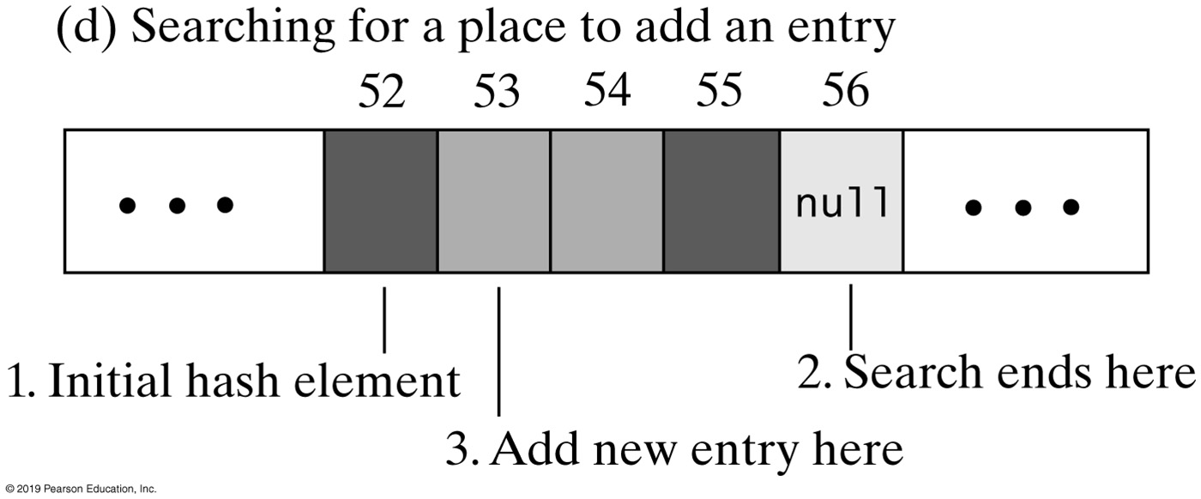
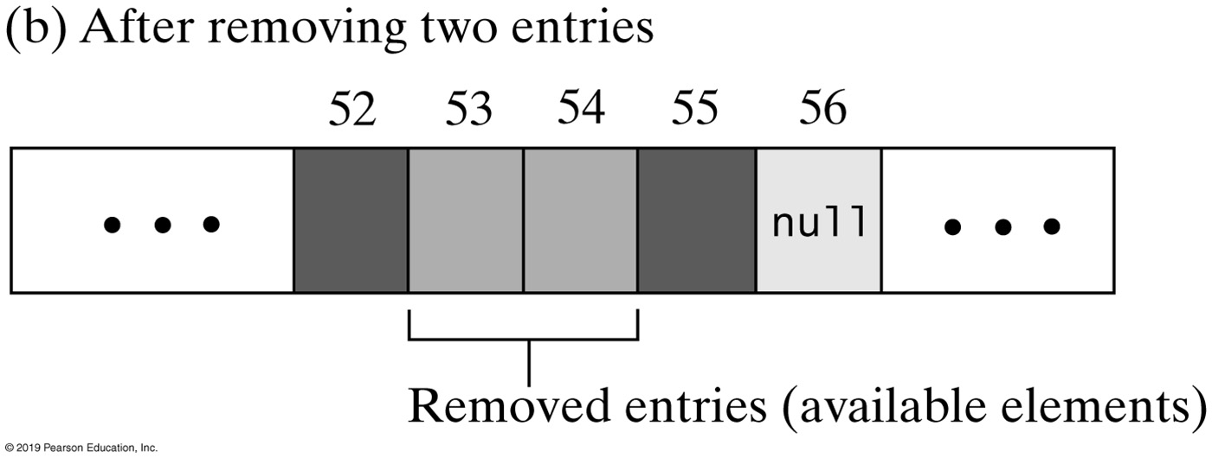
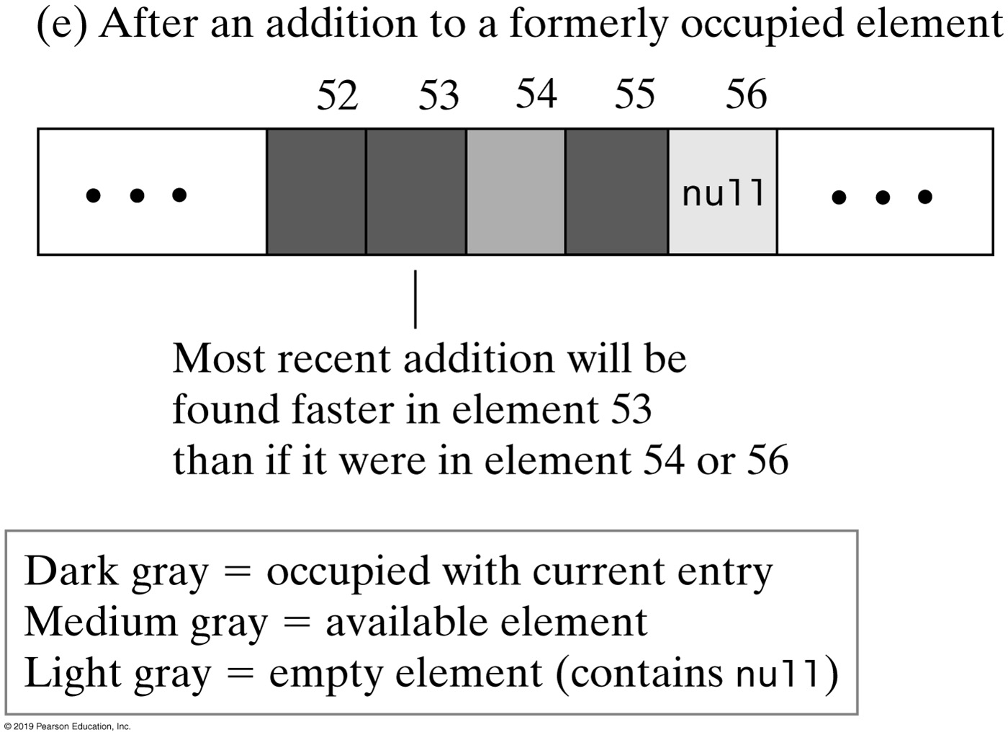
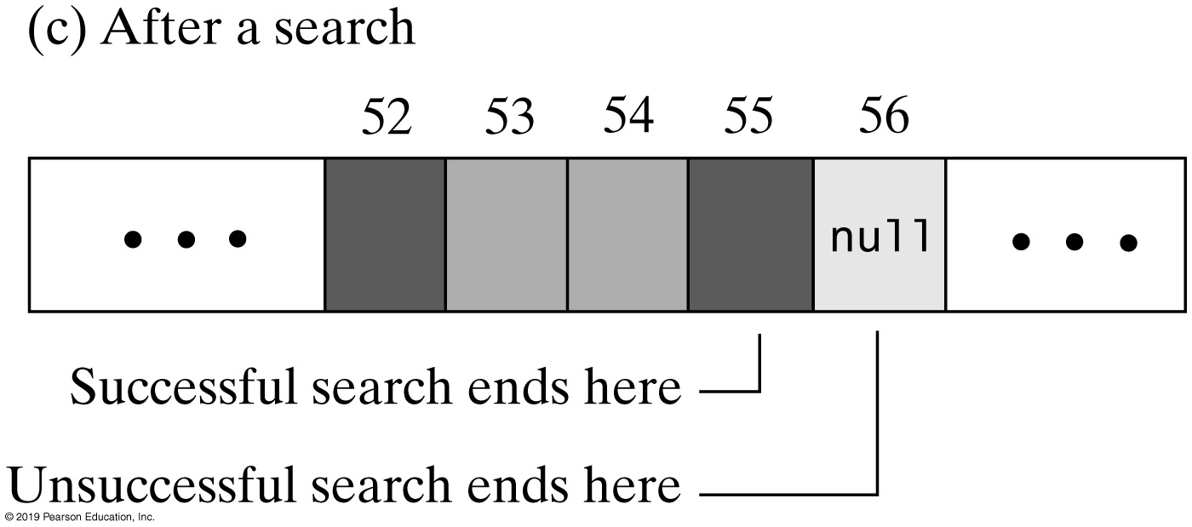
Linear Probing
FIGURE 22-6 The linear probe sequence in various situations

Slide 41
Clustering
Collisions resolved with linear probing cause groups of consecutive locations in hash table to be occupied
Each group is called a cluster
Bigger clusters mean longer search times following collision

Slide 42
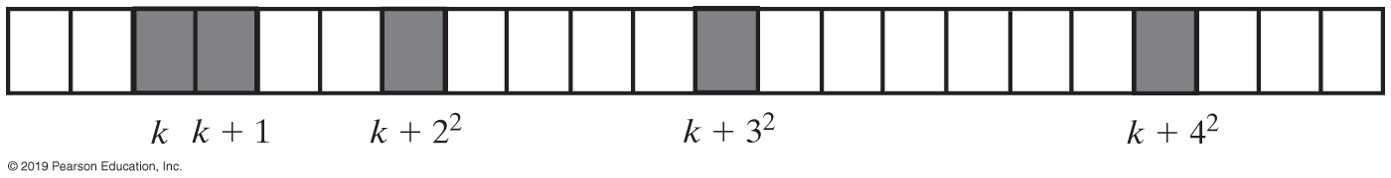
Open Addressing with Quadratic Probing
Linear probing looks at consecutive locations beginning at index k
Quadratic probing:
Considers the locations at indices k + j²
Uses the indices k, k + 1, k + 4, k + 9, …
FIGURE 22-7 A probe sequence of length five using quadratic probing

Slide 43
Example of quadratic probing:
Using a hash function of k % 7, add the following values to a hash table of size 7, using quadratic probing to resolve collisions:
5, 12, 19, 26

Slide 44
Open Addressing with Double Hashing
Linear probing and quadratic probing add increments to k to define a probe sequence
Both are independent of the search key
Double hashing uses a second hash function to compute these increments
This is a key-dependent method.

Slide 45
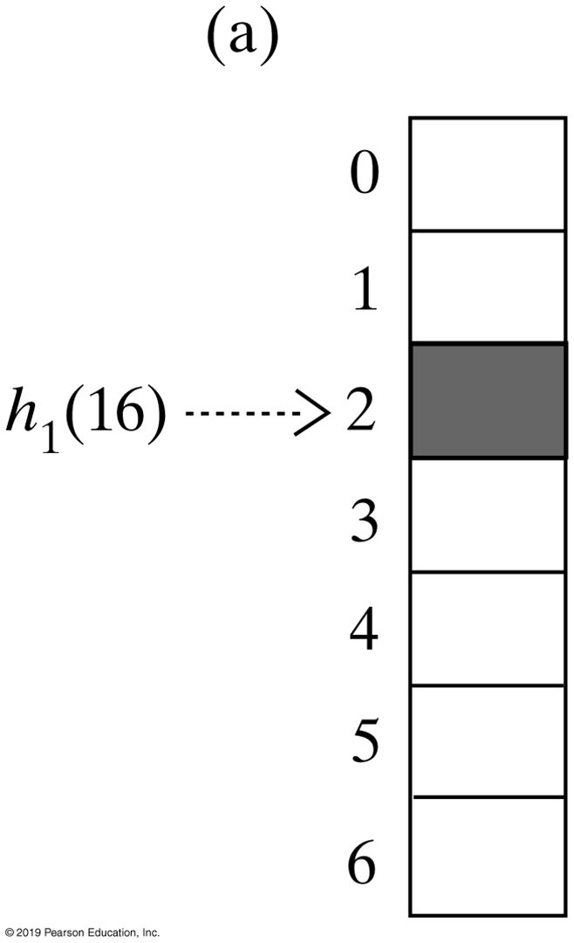
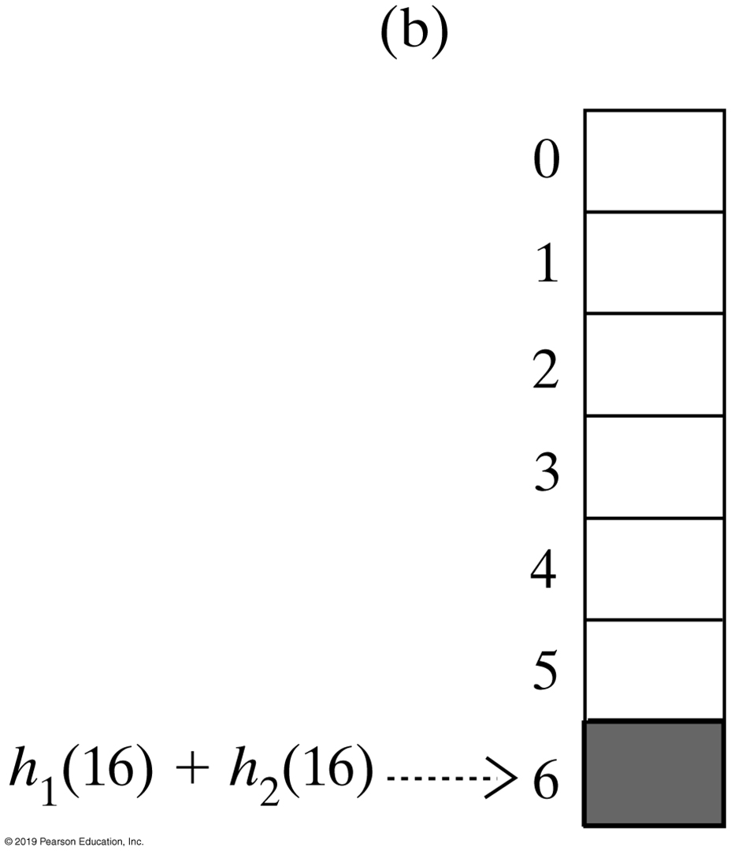
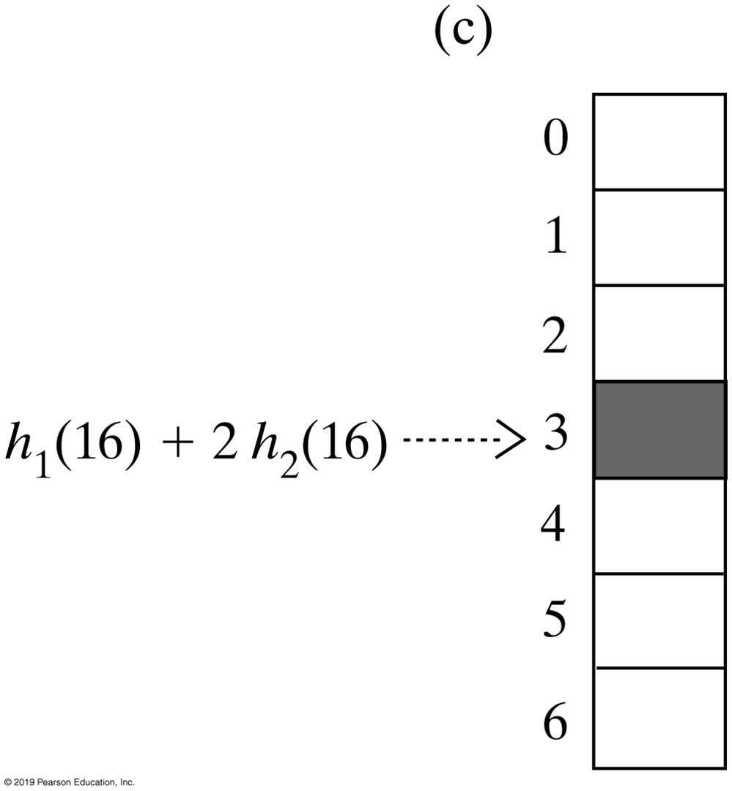
Open Addressing with Double Hashing
FIGURE 22-8 The first three elements in a probe sequence generated by double hashing for the search key 16

Slide 46
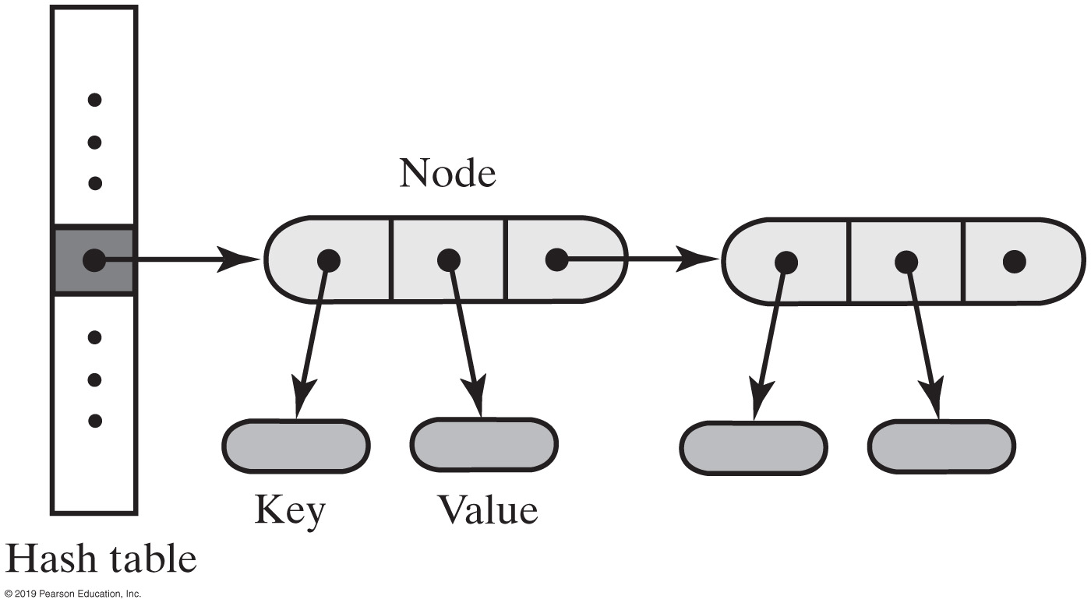
Separate Chaining
Alter the structure of the hash table
Each location can represent more than one value.
Such a location is called a bucket
Decide how to represent a bucket
list, sorted list
array
linked nodes
vector
FIGURE 22-9 A hash table for use with separate chaining; each bucket is a chain of linked nodes

Slide 47
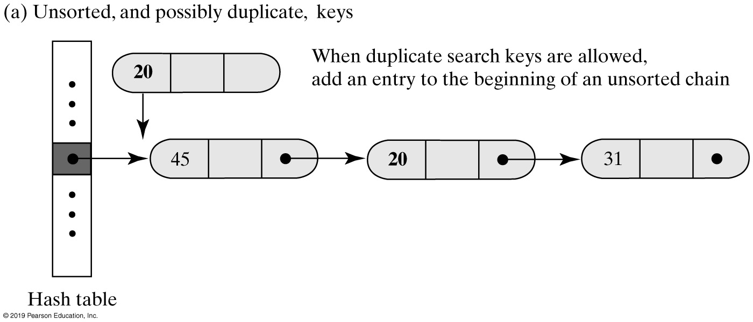
Separate Chaining
FIGURE 22-10a Inserting a new entry into a linked bucket according to the nature of the integer search keys

Slide 48
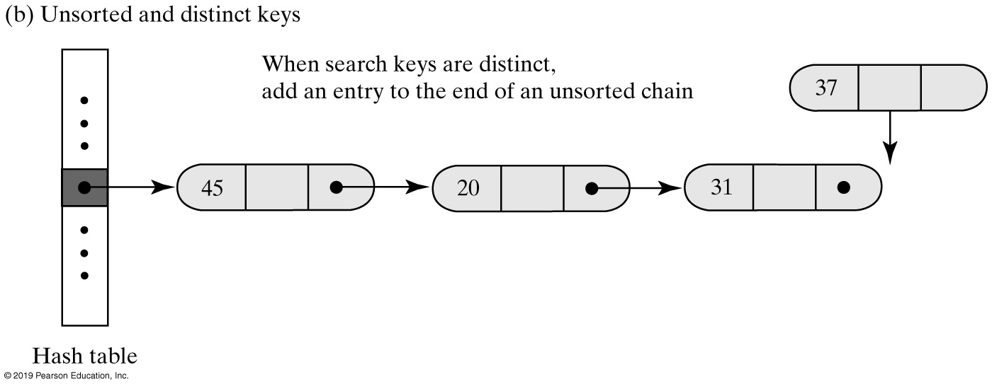
Separate Chaining
FIGURE 22-10b Inserting a new entry into a linked bucket according to the nature of the integer search keys

Slide 49
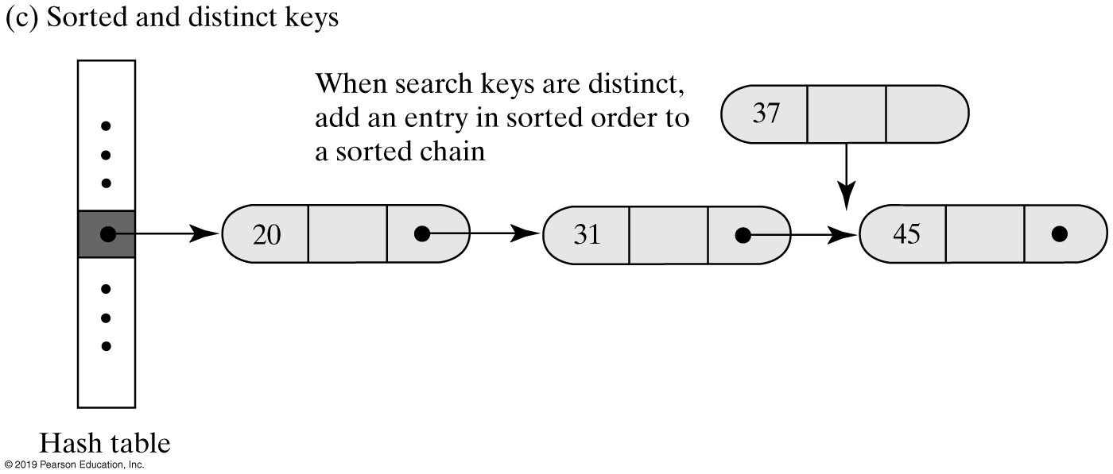
Separate Chaining
FIGURE 22-10c Inserting a new entry into a linked bucket according to the nature of the integer search keys

Slide 50
Example of separate chaining:
Using a hash function of k % 7, add the following values to a hash table of size 7, using separate chaining to resolve collisions:
5, 24, 14, 12, 19

Slide 51
Efficiency of Hashing
Observations about the time efficiency of these operations
Successful retrieval/removal has same efficiency as successful search
Unsuccessful retrieval/removal has same efficiency as unsuccessful search
Successful addition has same efficiency as unsuccessful search
Unsuccessful addition has same efficiency as successful search

Slide 52
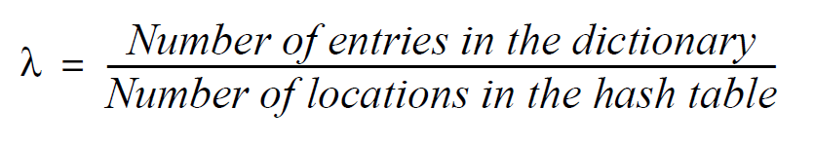
Load Factor
Definition of load factor:
Never negative
For open addressing, 1 ≥ λ
For separate chaining, λ has no maximum value
Restricting size of λ improves performance

Slide 53
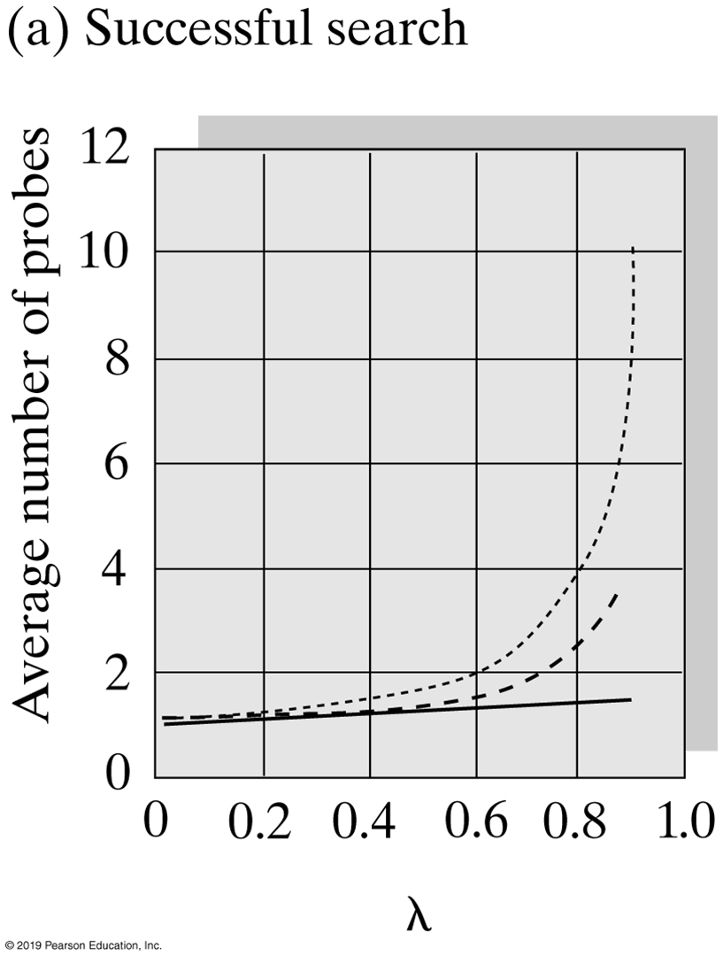
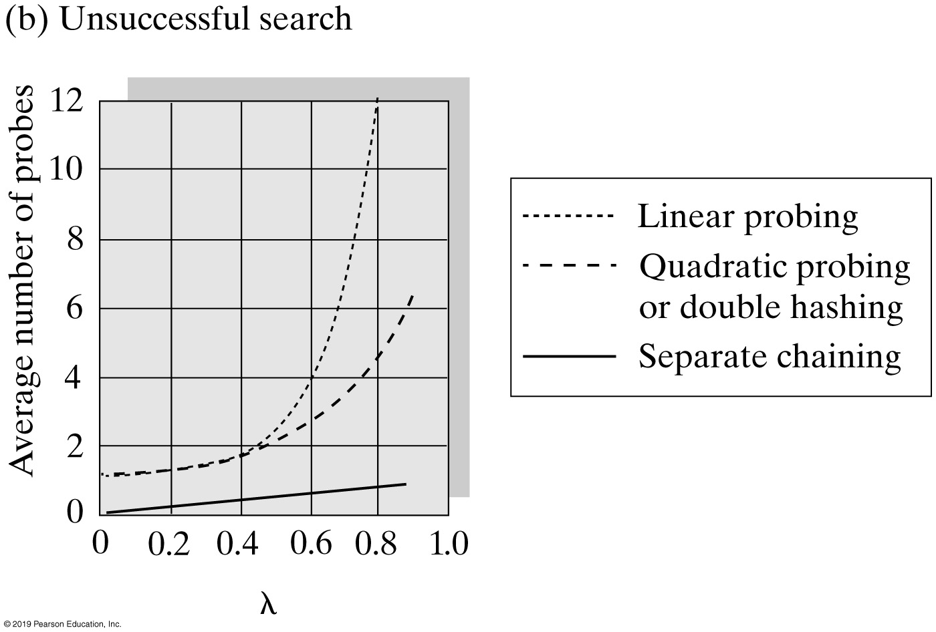
Comparing Schemes for Collision Resolution
FIGURE 23-4 The average number of comparisons required by a search of the hash table versus the load factor λ for four collision resolution techniques

Slide 54
Rehashing
When the load factor λ becomes too large must resize the hash table
Compute the table’s new size
Double its present size
Increase the result to the next prime number
Use method add to add the current entries in dictionary to new hash table

Slide 55
END

